Slide 1
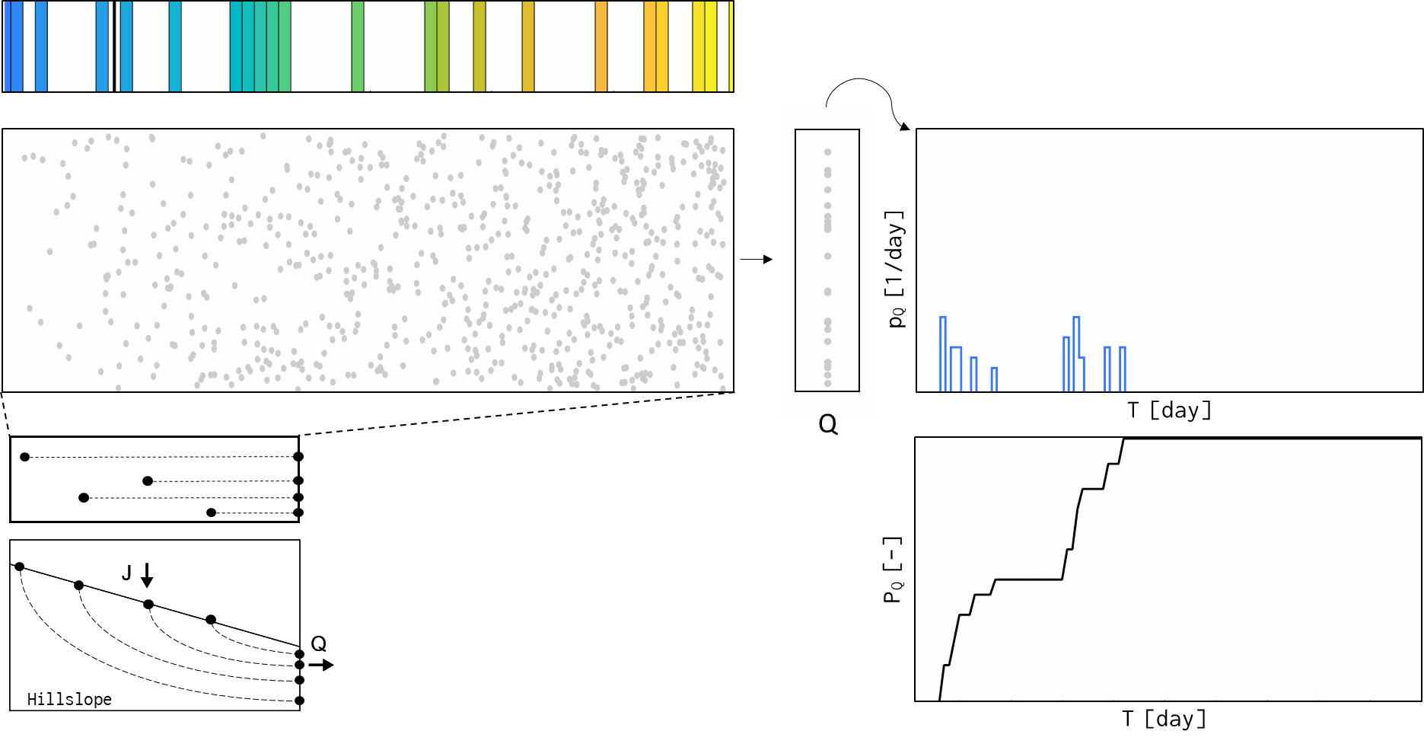
TRANSIT TIME DISTRIBUTION
Time
Rainfall
(A)
Water particles in hillslope
(B)
(C)
(D)
Transit time frequency of
water particles in discharge
= Transit time distribution
Water particles in discharge
(E)
Cumulative
transit time distribution
Notes:
Let me talk about transit time distribution under unsteady state or for a time-variable hydrologic system.
I am going to show an animated example for an idealized hillslope.
The top-left panel shows a rainfall sequence. And the below on shows water particles inside the hillslope. The grey colored water particles are those already in the hillslope, and I will injected new particles that colored corresponds to the rainfall sequence.
The figure on the right shows the water particle that exits from the hillslope at each time, and the most right one shows the transit time distribution.
And below the figure, I show the cumulative transit time distribution.

Slide 2
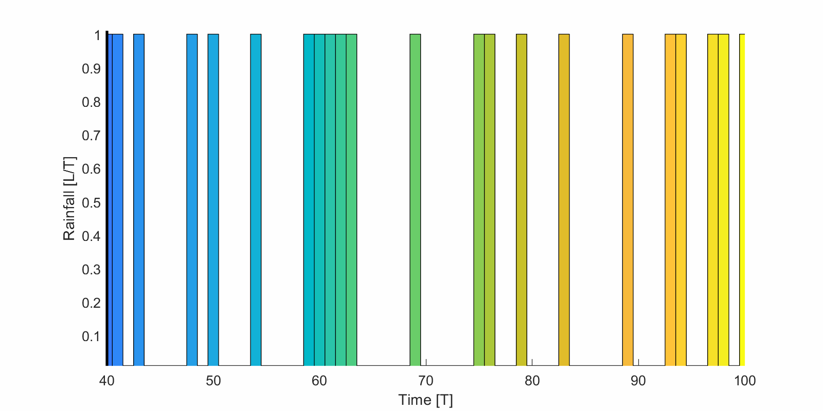

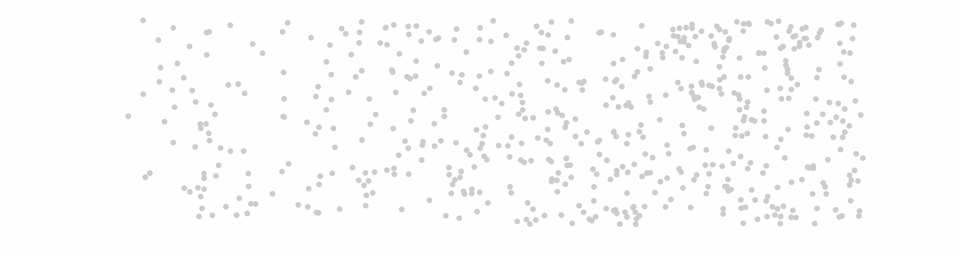
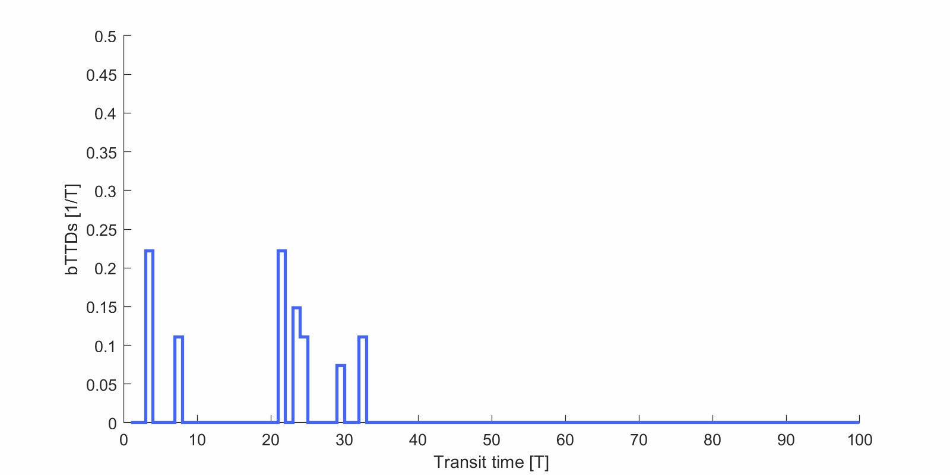
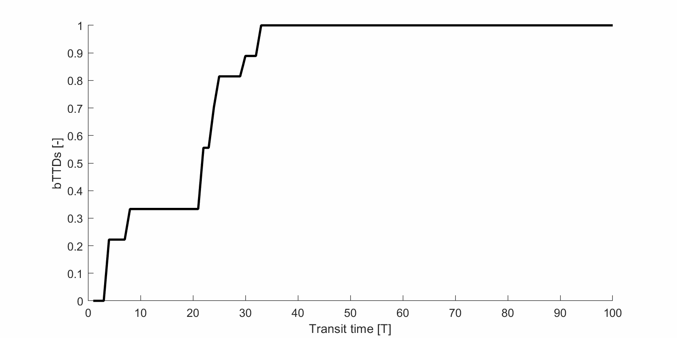
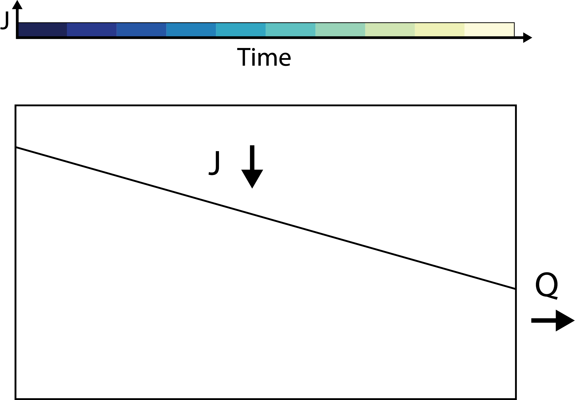
TRANSIT TIME DISTRIBUTION
Rainfall
Water particles in hillslope
Transit time frequency of
water particles in discharge
= Transit time distribution
p_{Q} [1/day]
Q
T [day]
Water particles in discharge
P_{Q} [-]
Cumulative
transit time distribution
Hillslope
T [day]
Notes:
As you can see, the discharging water is composed of diversely colored water, and the transit time distribution is very complicated and time-varying.
And it makes parameterizing the transit time distribution very difficult.

Slide 3
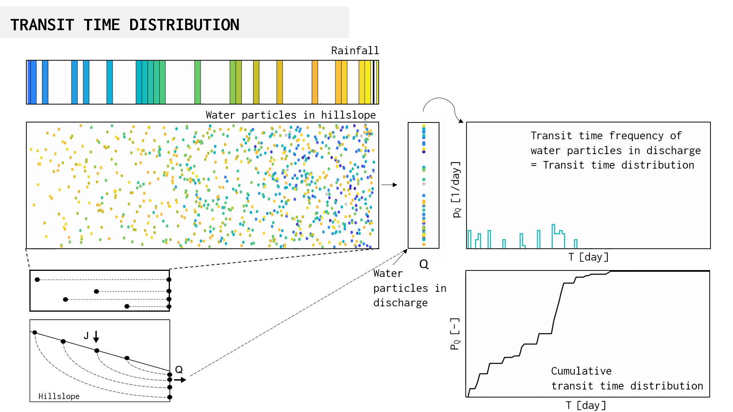
TRANSIT TIME DISTRIBUTION
Injection time t₀ = t-T
Time t
Transit time T
Hillslope
Notes:
One of the difficulties in parameterizing the transit time distribution is the flat areas in the cumulative transit time distribution.
It is because there was no discharging particle that has a correspond transit time, and that is because there was no rainfall at the associated injection time

Slide 4

TRANSIT TIME DISTRIBUTION (UNSTEADY)
Rainfall
Water particles in hillslope
Transit time frequency of
water particles in discharge
= Transit time distribution
p_{Q} [1/day]
Q
T [day]
Water particles in discharge
P_{Q} [-]
Cumulative
transit time distribution
Hillslope
T [day]
Notes:
And if we see the animation again, that flat areas are shifting in time, and it makes parameterizing time variable transit time distribution difficult.

Slide 5


SAS FUNCTION MAY PROVIDE BETTER FRAMEWORK
Rsas function may provide better framework
StorAge Selection function
Symbol of the SAS function
Botter et al., 2011, Geophysical Research Letters
van der Velde et al., 2012, Water Resources Research
Harman, 2015, Water Resources Research
Notes:
Now I am going talk about SAS function. SAS is the acronym for StorAge Selection, and this is very new concept that has been developed since 2011.

Slide 6
Hillslope
Notes:
And again, I am going to explain this with an illustration. There is a hillslope, and I am going to irrigate differently colored water again.

Slide 7
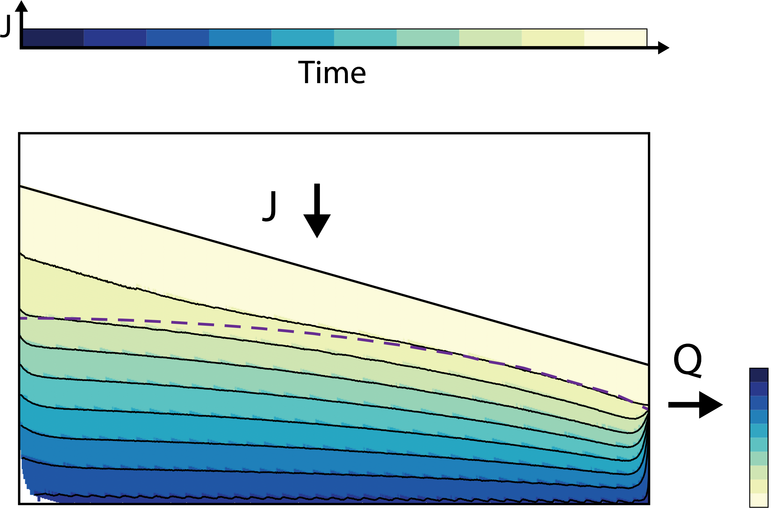
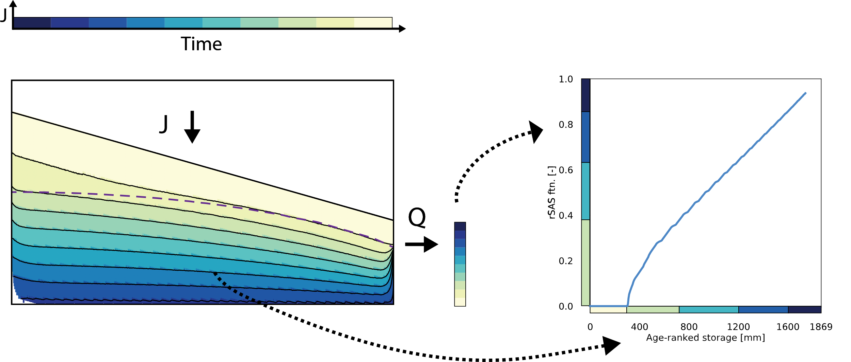
Notes:
And some time later, the hillslope will be filled with the differently colored water. And if you collect a water sample form discharge, you will get very differently colored water.

Slide 8

Ω_{Q} [-]
Age-ranked storage S_{T}
[mm]
Age-ranked storage
Notes:
And if we map, the differently colored water in the storage, a volume of water ranked by age, on the x-axis, and the faction of differently colored water in discharge on the y-axis,
[Age-ranked storage/ Age/ …]

Slide 9
Ω_{Q} [-]
Age-ranked storage S_{T}
[mm]
Notes:
And if we draw a line that connects each different color, then that is the SAS function.
So SAS function explains the system scale transport by relating internal age structure of water and the age structure in discharge.

Slide 10
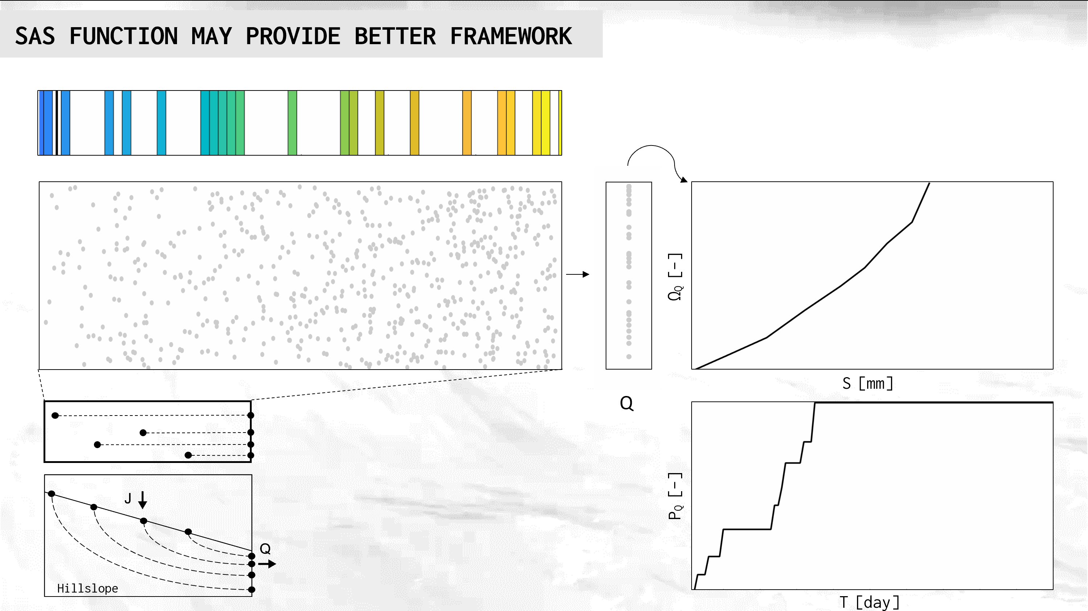
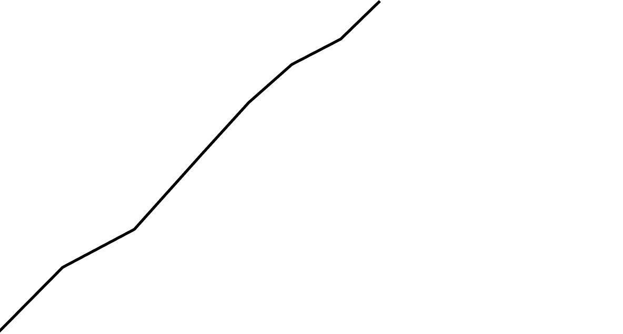
SAS FUNCTION MAY PROVIDE BETTER FRAMEWORK
Ω_{Q} [-]
SAS function
S [mm]
S_{T} [mm]
Q
P_{Q} [-]
Transit time distribution
Hillslope
T [day]
Notes:
Let’s go back to the animated example. I am now showing the SAS function and the cumulative transit time distribution.

Slide 11
SAS FUNCTION MAY PROVIDE BETTER FRAMEWORK
Ω_{Q} [-]
SAS function
S_{T} [mm]
Q
P_{Q} [-]
Transit time distribution
Hillslope
T [day]
Notes:
As you can see, the SAS function is much smoother and does not have the flat areas, while it does in the cumulative TTD.

Slide 12
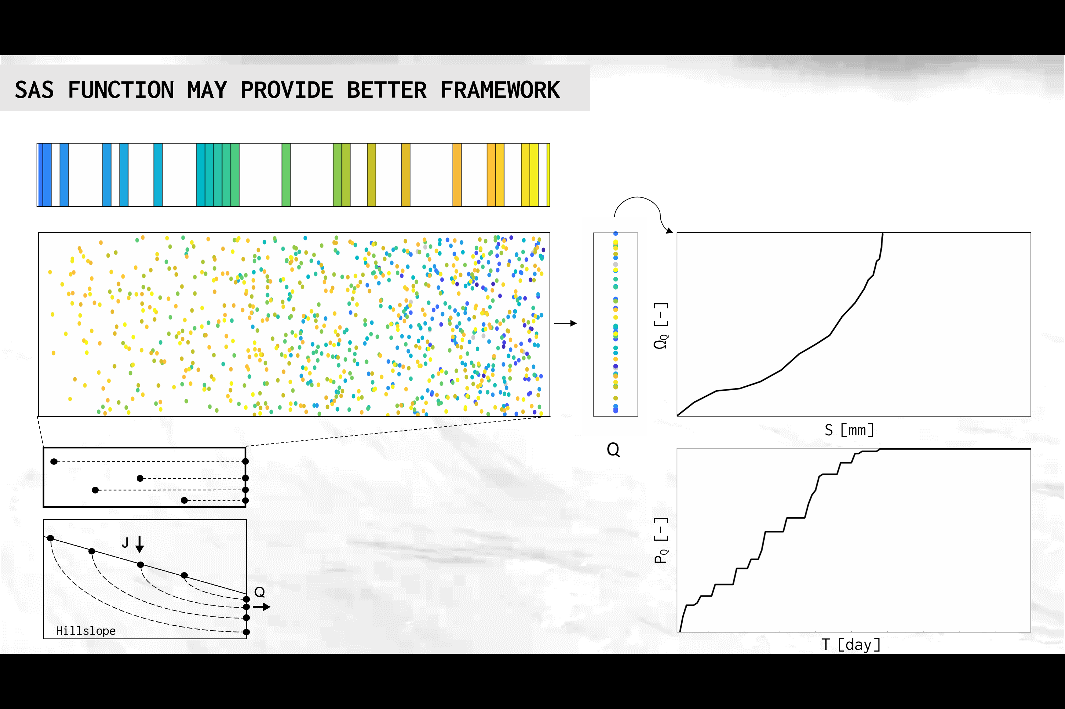
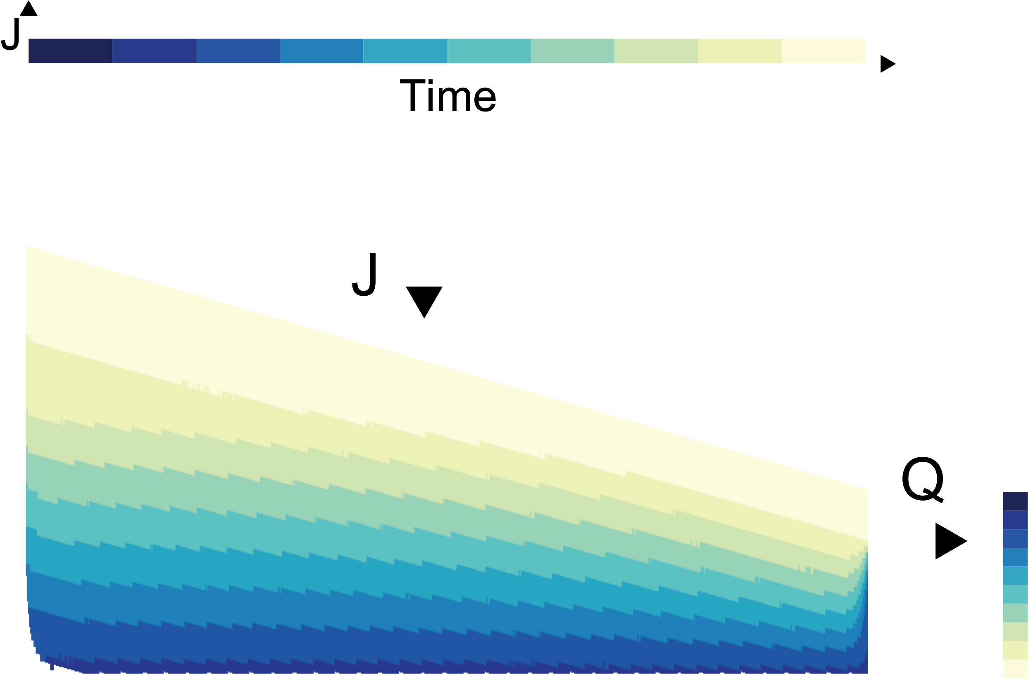
SAS FUNCTION MAY PROVIDE BETTER FRAMEWORK
Injection time t₀ = t-T
Rainfall
Time t
Water particles in hillslope
(Spatially-mapped)
Age-ranked storage
Ω_{Q} [-]
SAS function
S [mm]
S_{T} [mm]
Q
P_{Q} [-]
Transit time T
Transit time distribution
Hillslope
T [day]
Notes:
That is because there are no gaps in the age-ranked storage.

Slide 13
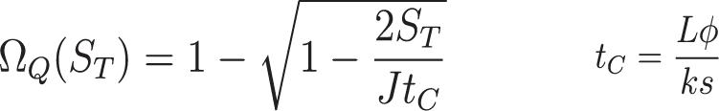

SAS FUNCTION MAY PROVIDE BETTER FRAMEWORK
Injection time t₀ = t-T
Rainfall
Time t
Water particles in hillslope
(Spatially-mapped)
Age-ranked storage
Ω_{Q} [-]
SAS function
S [mm]
S_{T} [mm]
Q
P_{Q} [-]
Transit time T
Transit time distribution
Hillslope
T [day]
Notes:
And we may be able to parameterize the SAS function using a mathematical formulation like this.

Slide 14
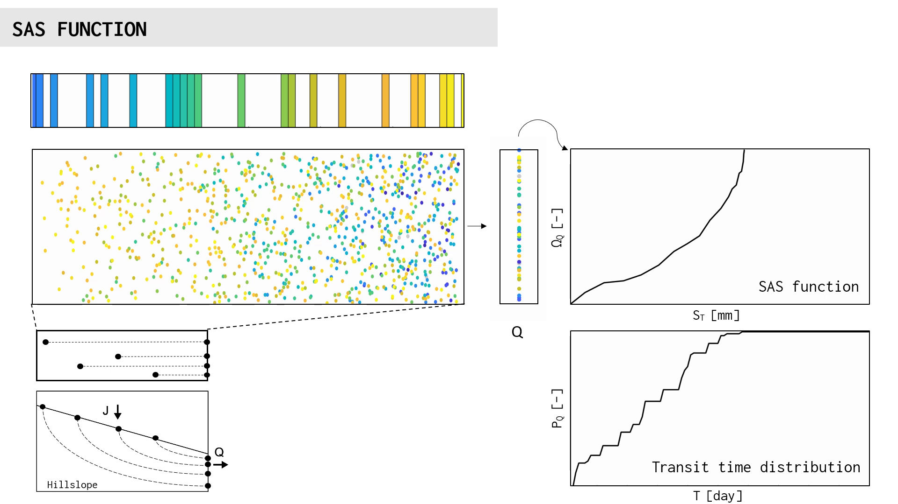
S [mm]
S_{T} [mm]
Notes:
And we may be able to parameterize the SAS function using a mathematical formulation like this.

